Slide 1

Keyword & Named Entity Recognition on Emergency Call Text
Hu Wanyu | U1721068J
Supervisor: Prof Chng Eng Siong
Date: 04 Dec 2020
Notes:
Good morning Prof, I am Wanyu. Today I will be presenting my Final Year Project on the topic Named entity Recognition on Emergency Call Texts.

Slide 2
Agenda
01 Project Background
02 Literature Review
03 Dataset and Dataset Generation
05 Experiment & Result
04 System Implementation & Design
06 Conclusion & Future Works
Notes:
These are the key points of the presentation. Firstly, I will be introducing the project background and objective. Followed by some of the research done over the topic of NER. After which I will be introducing the steps I used for data augmentation, followed by System Implementations and results, which includes a demo of the user interface. Finally, I will end my presentation with some of the future works and challenges of this project. Last but not least, I’ll answer any questions you may have.

Slide 3
01 Project Background
Motivations and Objectives
Notes:
So what is this project all about?

Slide 4
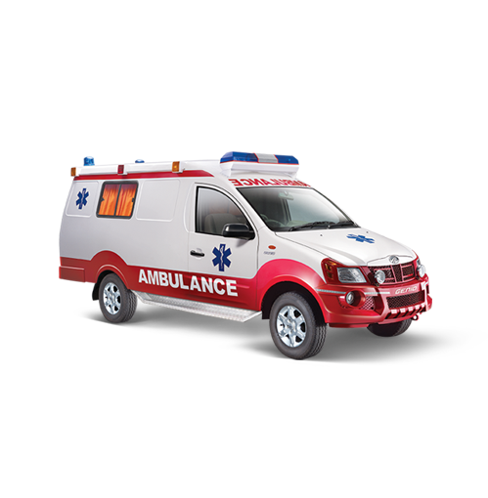

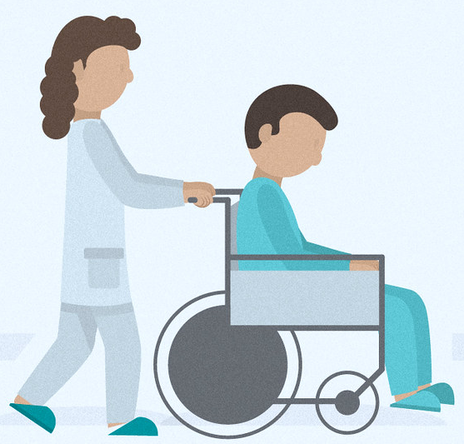

Motivation
2,500 lives
delayed ambulance response times.
790 calls
Emergency calls per day
Source: G. C, “Deaths due to Ambulance Delays: Clinical Negligence Team Blog,” Clinical Negligence Team, 24-Jul-2014. [Online]. Available: https://www.clinicalnegligenceteam.co.uk /blog/deaths-due-to-ambulance-delays/.
T. T. Mei, “Answering the (995) call with speed and efficiency,” The Straits Times, 25-Dec-2017. [Online]. Available: https://www.straitstimes.com/singapore/answering-the-995-call-with-speed-and-efficiency.
Notes:
According to Clinical Negligence Team of the UK, there are more than two thousand lives a year are being lost as a result of delayed ambulance response times. That’s a huge number.
Moreover, in Singapore, there are more than 790 emergency calls per day, means there is one call every 2 mins. but our civil defence phone operators are still manually typing patient’s information into the EMS system.
This causes a lot of delay in sending the ambulance to the patients. It is crucial to ensure that the ambulance reaches the patients as quick as possible, especially if the patients are suffering from critical conditions. One life lost is one too many and if we can prevent such tragedy happening again, then why not?
So, in view of the development of AI technology nowadays, why not replace those phone operators with an AI system. So that ambulance response time can be minimized. Which may save more lives

Slide 5
Objective and Scope
Apply NLP techniques and design a new domain-specific NER model for identifying and annotating the key entities of Emergency Call texts.
Notes:
So the aim of this project is to apply NLP techniques to design a new domain-specific NER model. This model should be able to identify and annotate all the relevant key entities in the sentence. What do I mean by “key entities”? Lets look at one example.

Slide 6
Example
Sentences:
Alex falls due to diabetes just now. He is bleeding. His address is Street A
[Alex]_{person} [falls]_{Events} due to [diabetes]_{Disease} [just now]_{Time}. He is [bleeding]_{Events}. The address is [Street A]_{Address}.
Categories:
Person
Events
Disease
Time
Address
Notes:
Alex falls due to diabetes just now. He is bleeding. His address is Street A
There are 5 categories of entity in this sentence. Alex is under the category of Person. Falls is under the category of events. Diabetes is under the disease entity. The phrase just now is under time entity and Street A is the address entity. Our task is to train the model to identify those entities as accurate as possible.

Slide 7
02 Literature Review
What are NER, and BERT model?
Notes:
So what are the NER techniques I used in this project. Before that, What is NER in the first place?

Slide 8
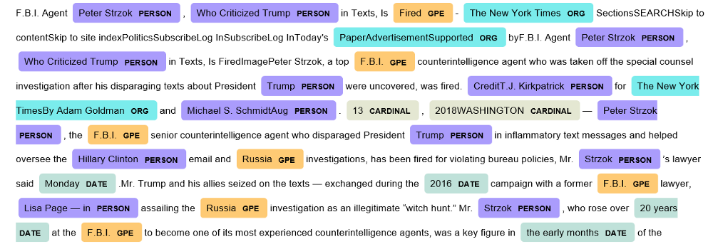
Named Entity Recognition
Extracting and classifying tokens in the sentence into predefined entities categories, such as Person, Location, Organisations and so on.
Entities
Person
Organization
Location
Disease
Miscellaneous
Notes:
NER is a subtask of information extraction. It is the process of classifying tokens in the sentence into pre-defined entities. In this project, the entities used are Person, Location, Organisations and “Disease”, Disease entity will extract all the injuries and medical conditions from the sentence.

Slide 9
Named Entity Recognition
Rule-based
Probabilistic
Notes:
There are several approaches to build a NER model.
Rule-based approach identifies entities based on grammar and syntactic patterns. However, its limitation is that every time when there are changes in syntax in the sentence, the rule must be changed accordingly.
For the probabilistic approach, the model is trained over a large amount of data. The resulting model have the capabilities of tagging tokens on unseen dataset.
For this project, I will be using the probabilistic approach.

Slide 10
BERT
Bidirectional Encoder Representations from Transformers
Transformer Architecture
Bidirectional
Encoder Decoder network
Source: https://jalammar.github.io/illustrated-transformer/
Notes:
Bidirectional Encoder Representations from Transformers (BERT) model is a powerful pre-trained probabilistic model. As the name suggested, BERT took advantage of Transformer Architecture, together with its bidirectional technique, and Encoder Decoder network.
BERT is easy to use. The user only requires to “fine-tune” this model with new dataset.

Slide 11
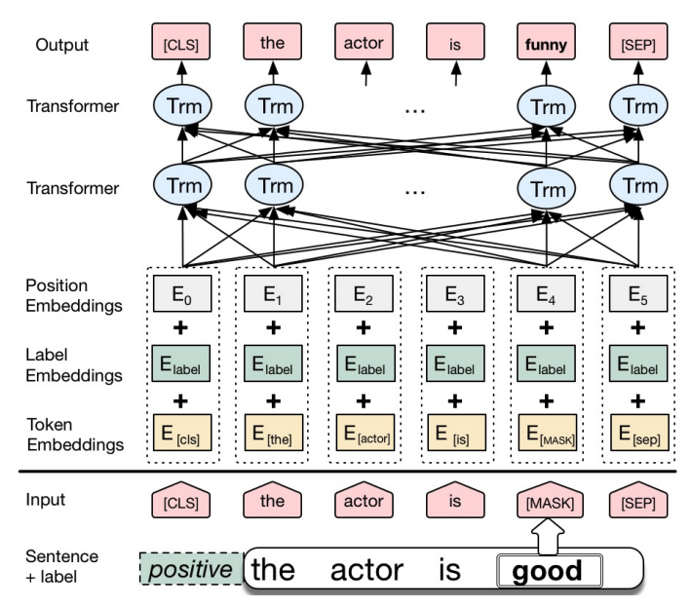
BERT
Tokenize into tokens
Three Embeddings
Train BERT Model
Notes:
The steps of training a BERT model are
Firstly, input sentences are tokenised into a sequence of tokens
Then, embed the sequence of tokens using three embedding layers to produce a high dimensional vector. This vector space contains word, sentence and positional information.
Lastly, input this vector space into the Transfoemers network to start the training.
So how does the model tokenize word?

Slide 12
BERT
Tokenize into tokens
Three Embeddings
Train BERT Model
𝑃(𝑇𝑜𝑘𝑒𝑛|𝑊𝑜𝑟𝑑)
Notes:
BERT tokenizer uses Wordpiece tokenizer. The tokenizer tries to search for the token among all its pre-trained tokens and find the highest likelihood to the input word

Slide 13
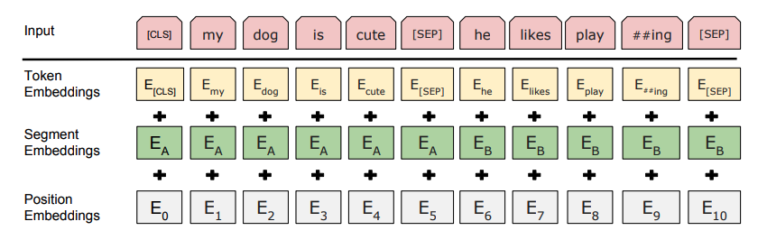
BERT
Tokenize into tokens
Three Embeddings
Train BERT Model
L. Tai and M. Liu, “Deep-learning in Mobile Robotics - from Perception to Control Systems: A Survey on Why and Why not,” December 2016. [Online]. Available: https://www.researchgate.net/publication/311805526_Deep-learning_in_Mobile_Robotics_-_from_Perception_to_Control_Systems_A_Survey_on_Why_and_Why_not.
Notes:
BERT uses three layers of embeddings to compute the synaptic input u.
They are “Token Embeddings”, which vectorizes the input tokens
“Sentence Embeddings”, which perform embeddings on whole sentence.
“Position Embeddings”, which contains the positional input of the input tokens
The final input embeddings are the sum of the three embedding layers.

Slide 14
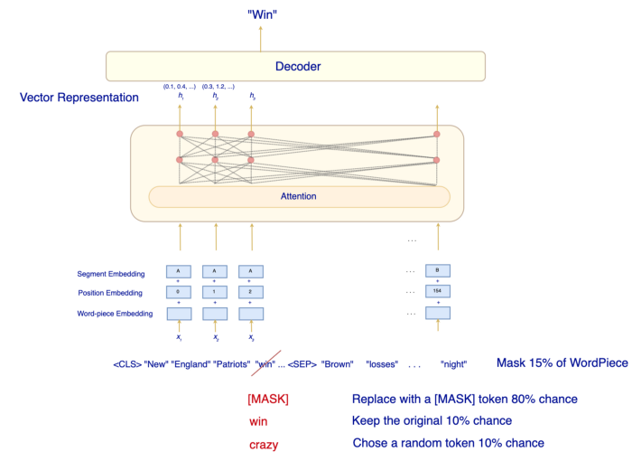
BERT
Tokenize into tokens
Three Embeddings
Train BERT Model
G. Loye, “Attention Mechanism,” 15 SEPTEMBER 2019. [Online]. Available: https://blog.floydhub.com/attention-mechanism/. [Accessed SEPTEMBER 2020]
Notes:
The final step is that The model predicts the masked words and compare the predicted result with the actual result.

Slide 15
Generate New Sentences?
Sentence | Bob | Ng | is | suffering | from | heart | failure | at | Temasek | Holdings | in | Orchard | Road
Tags | B-PER | I-PER | O | O | O | B-DIS | I-DIS | O | B-ORG | I-ORG | O | B-LOC | I-LOC
BERT
Sentence | #### | Ng | is | #### | from | heart | #### | at | #### | #### | in | #### | Road
Tags | B-PER | I-PER | O | O | O | B-DIS | I-DIS | O | B-ORG | I-ORG | O | B-LOC | I-LOC
BERT
New Sentence | Max | Ng | is | hurting | from | heart | disease | at | National | Gallery | in | Bugis | Road
Tags | B-PER | I-PER | O | O | O | B-DIS | I-DIS | O | B-ORG | I-ORG | O | B-LOC | I-LOC
15
Notes:
So after learning how BERT works, I have one question: Can we use the same concept of mask to create some new sentences?
The answer is yes! And I used it for data augmentation

Slide 16
03 Dataset and Data Augmentation
Pre-processing of data and Generation of data
Notes:
Before going deep into data augmentation, lets talk about what are the existing dataset?

Slide 17
Dataset
Online
Augmentation
Augment new sentences using model based on existing dataset
Online Emergency Call Texts Dataset

Slide 18
Dataset
Online
Augmentation
Augment new sentences using model based on existing dataset
Online Emergency Call Texts Dataset

Slide 19
Online Dataset
CONLL2003
WNUT 17 (Emerging Entities’17)
NCBI disease corpus + i2b2/VA dataset.
Notes:
I have found 3 relevant dataset online. They are CONLL2003, WNUT 17 (Emerging Entities’17) and NCBI disease corpus + i2b2/VA dataset.

Slide 20
Online Dataset
CONLL2003
WNUT 17 (Emerging Entities’17)
NCBI disease corpus + i2b2/VA dataset.
Notes:
The CONLL2003 is a well-known dataset that contains commonly used words. It is famous for its high accuracy and F1 score.
But there is one issue in using a popular dataset: the model can achieve a high accuracy and F1 score when it is predicting common words. But, when it comes to rarer words or entities, the model tends to perform badly. Since the project focus is on named entities on emergency call text, we also ned to deal with spoken language which contains lot of uncommon phrases

Slide 21
Online Dataset
CONLL2003
WNUT 17 (Emerging Entities’17)
NCBI disease corpus + i2b2/VA dataset.
Notes:
To tackle this issue, we need a more generalized dataset which can train the model to be less sensitive to new changes.
So there comes Emerging Entities’17. It contains mostly rare and unseen entities types
This dataset provides our model the capability of classifying the rare named entities in a noisy text environment.

Slide 22
Online Dataset
CONLL2003
WNUT 17 (Emerging Entities’17)
NCBI disease corpus + i2b2/VA dataset.
Notes:
Finally, The two medical dataset NCBI disease corpus + i2b2/VA are used for training the model to learn different types of injuries and medical conditions.

Slide 23
Dataset
Online
Augmentation
Augment new sentences using model based on existing dataset
Online Emergency Call Texts Dataset
Notes:
Now I will introducing data augmentation using BERT model.

Slide 24
Data Augmentation
Load pre-trained Transformers Model
Mask some tokens in sentence
Replace the masked tokens by model
New Sentence Generated
Input Sample Sentences
Process:
Notes:
Since most of the medical dataset online are confidential, I decide to augment medical sentences based on existing dataset.
Traditionally this is commonly achieved by replacing the words with similar meanings.
In this project, I made use of the masking mechanism of transformer models for data augmentation.
The steps for data augment are: firstly, I load a pre-trained Transformers model

Slide 25
Data Augmentation
Load pre-trained Transformers Model
Mask some tokens in sentence
Replace the masked tokens by model
New Sentence Generated
Input Sample Sentences
Sample Sentence | Scott | McClellan | said | the | remarks | concerns | about | Iran | ‘s | nuclear | intensions | .
Tags | B-PER | I-PER | O | O | O | O | O | B-LOC | O | O | O | O
Model | Time Taken for 130,000 sentences | Generated Sentence
BERT-based-cased | 14 hrs+ | Scot Hicks said the remarks echoed the comments concerning Iran’s nuclear intensions.
DistilBERT-based-cased | 10 hrs+ | George McClellan said these remarks underscore these concerns about publicly expressing nuclear intensions.
DistilRoBERTa-base | 10 hrs+ | Michael McClellan says the memos underscore the skepticism about Russia voicing hostile intensions.
BEST Model
Notes:
I have compared different models and checked their performance.
At first I used the BERT-based-cased model. It performs quite well. But it takes more than 14 hours to generate all the 130 thousand new sentences.
So to decrease the generation time, I tried a distilled version of BERT model. But the accuracy is not that good. It wrongly replaced the Location tag.
In the end, I decided to use DistilRoBERTa-base because both its generation time and accuracy are acceptable.

Slide 26
Data Augmentation
DistilRoBERTa-base
Mask some tokens in sentence
Replace the masked tokens by model
New Sentence Generated
Input Sample Sentences
Sentence | Bob | Ng | is | suffering | from | heart | failure | at | Temasek | Holdings | in | Orchard | Road
Tags | B-PER | I-PER | O | O | O | B-DIS | I-DIS | O | B-ORG | I-ORG | O | B-LOC | I-LOC
Notes:
Next step is to input some sample sentences so that the model can augment in the same format as sentence.

Slide 27
Data Augmentation
DistilRoBERTa-base
Mask some tokens in sentence
Replace the masked tokens by model
New Sentence Generated
65,000 Sample Sentences
Sentence | Bob | Ng | is | suffering | from | heart | failure | at | Temasek | Holdings | in | Orchard | Road
Tags | B-PER | I-PER | O | O | O | B-DIS | I-DIS | O | B-ORG | I-ORG | O | B-LOC | I-LOC
Sentence | #### | Ng | is | #### | from | heart | #### | at | #### | #### | in | #### | Road
Tags | B-PER | I-PER | O | O | O | B-DIS | I-DIS | O | B-ORG | I-ORG | O | B-LOC | I-LOC
Notes:
The model then incrementally mask some tokens

Slide 28
Data Augmentation
DistilRoBERTa-base
Mask maximum 7 tokens randomly in one sentence
Replace the masked tokens by model
New Sentence Generated
65,000 Sample Sentences
Sentence | Bob | Ng | is | suffering | from | heart | failure | at | Temasek | Holdings | in | Orchard | Road
Tags | B-PER | I-PER | O | O | O | B-DIS | I-DIS | O | B-ORG | I-ORG | O | B-LOC | I-LOC
Sentence | #### | Ng | is | #### | from | heart | #### | at | #### | #### | in | #### | Road
Tags | B-PER | I-PER | O | O | O | B-DIS | I-DIS | O | B-ORG | I-ORG | O | B-LOC | I-LOC
New Sentence | Max | Ng | is | hurting | from | heart | disease | at | National | Gallery | in | Bugis | Road
Tags | B-PER | I-PER | O | O | O | B-DIS | I-DIS | O | B-ORG | I-ORG | O | B-LOC | I-LOC
Notes:
then replace it with a token generated by the pre-trained model

Slide 29
Data Augmentation
DistilRoBERTa-base
Mask maximum 7 tokens randomly in one sentence
Replace the masked tokens by model
New Sentence Generated
65,000 Sample Sentences
Sentence | Bob | Ng | is | suffering | from | heart | failure | at | Temasek | Holdings | in | Orchard | Road
Tags | B-PER | I-PER | O | O | O | B-DIS | I-DIS | O | B-ORG | I-ORG | O | B-LOC | I-LOC
New Sentence | Max | Ng | is | hurting | from | heart | disease | at | National | Gallery | in | Bugis | Road
Tags | B-PER | I-PER | O | O | O | B-DIS | I-DIS | O | B-ORG | I-ORG | O | B-LOC | I-LOC
Notes:
a new sentence is generated.

Slide 30
Dataset
570,000 Emergency Call Sentences
57,000 Sentences
57,000 Sentences
513,000 Sentences
130,000 Augmented Sentences
440,000 Sentences
8 : 1 : 1
Training Validation Testing
Notes:
This is the break down of all the data. Out of 570 thousand sentences, around 30% of the sentences are generated. Training to validation to Testing ratio is 8 to 1 to 1

Slide 31
BIO Tagging Scheme
Tags | Meaning
B-PER | B-Person
I-PER | I-Person
B-ORG | B-Organization
I-ORG | I-Organization
B-LOC | B-Location
I-LOC | I-Location
B-DIS | B-Disease
I-DIS | I-Disease
B-MISC | B-Miscellaneous
I-MISC | I-Miscellaneous
O | Out of Vocab
PAD | Padding
Tag | Description
“B” | Token is the beginning of an entity
“I” | Token is inside an entity
“O” | Token is outside an entity
Sentence | Bob | Ng | is | suffering | from | heart | failure | at | Temasek | Holdings | in | Orchard | Road
Tags | B-PER | I-PER | O | O | O | B-DIS | I-DIS | O | B-ORG | I-ORG | O | B-LOC | I-LOC
Notes:
To apply machine learning algorithms to NER task, annotated data are converted into a BIO format. BIO is a common tagging scheme used for named entity recognition. It assigns each word into a class of BIO tags. “B” stands for the beginning of the entity; “I” represents the token is inside of an entity, “O” stands for the token is outside of an entity. By doing this, NER problem now becomes classification problem of sequential labeling.
The table on the right are all the tags I used for the data.

Slide 32
04 System Implementation & Design

Slide 33
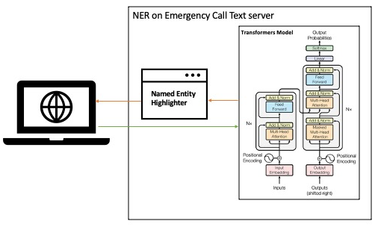
System Architecture
Notes:
The system architecture of the project is a client and server model. The Transformers encoder encodes input sentences, go through the model, and then decod by Transformers Decoders. The named entities will be highlighted and displayed to the client.

Slide 34
05 Experiment & Result

Slide 35

Training
Pre-process the Data
BERT Model
Predict
Iterator
Source: https://www.marketing-branding.com/google-colaboratory-colab-guia-completa-espanol/
Notes:
The model is trained on Google Colab with GPU function with dropout rate of 0.1, batch size of 32 and learning rate of 3*e-5 for 5 epochs.

Slide 36
Result
 | Accuracy | Loss | F1 Score
Training | 0.992089279 | 0.025385366 | 0.91
Validation | 0.954151639 | 0.191778849 | 0.91
 | Precision | Recall | F1-Score
ORGANIZATION | 0.89 | 0.91 | 0.90
LOCATION | 0.93 | 0.95 | 0.94
PERSON | 0.94 | 0.87 | 0.90
DISEASE | 0.85 | 0.89 | 0.87
MISC | 0.86 | 0.88 | 0.87
AVERAGE | 0.90 | 0.91 | 0.91
Notes:
The performance of the model is quite well, with validation accuracy of 95.4% and F1 score of 91%

Slide 37
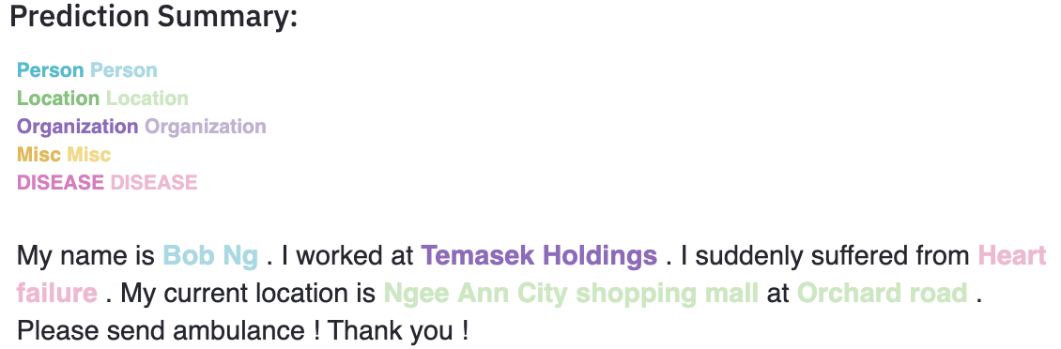
Result
Notes:
This is the result of the predicted sentence. IT successfully identifies all the named entities.

Slide 38
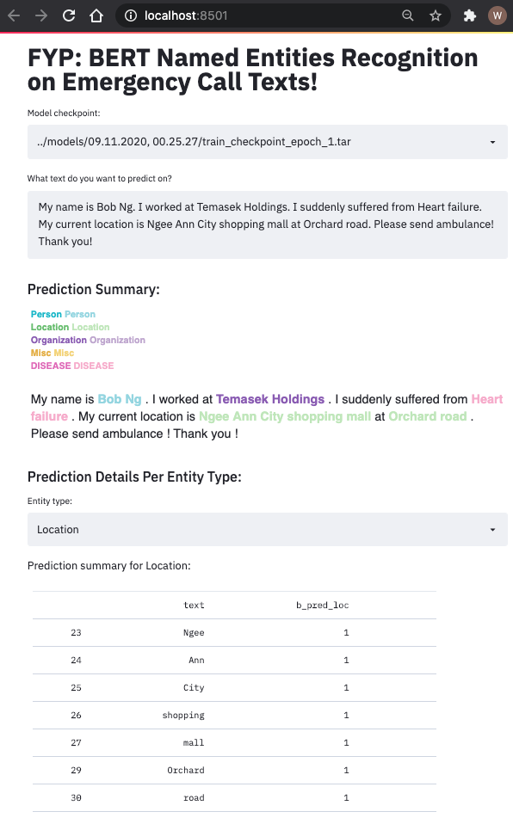
Interface Design
Choose NER Model
Input Text to Predict
Display the annotated Entities
Filter Results by Entity types
Notes:
This is the user interface of the project. Users firstly choose their model, and input text to predict. The annotated entities are display below. Users can filter the results by entities types.

Slide 39
06 Conclusion & Future Works

Slide 40
Conclusion
95.4%
Validation Accuracy
91.0%
F1 Score
Notes:
In conclusion, the performance of the BERT model is quite acceptable. It achieved 95.4% of validation accuracy and 91.0% of F1 score. The key contributions for this project are: I build the complete BERT NER model, searched for relevant corpus and generated new data sentences, and last but not the least, I designed the user interface to highlight the key entities.

Slide 41
Future Work
Corpus
Time
Uncased words
Notes:
The performance of the model can be further improved. Here are some of the recommendations that may enhance the accuracy of the model:
1) The model can be trained over more specific corpora, which includes more specific entities, such as block number and floor number of a location.
2) The current training time is more than 10 hours. It should be optimized.
3) The model can be re-trained with uncased words. Since text comes from spoken language, model must be capable of recognizing all the uncased named entities as well.

Slide 42
Q & A

Slide 43
Thank you

Slide 44
Appendix

Slide 45
Padding/Truncating
Padding:
[CLS] | This | sentence | has | sequence | length | of | less | than | 512 | tokens | ...... | PAD | [SEP]
Truncating:
[CLS] | This | sentence | has | sequence | length | of | more | than | 512 | tokens | some | texts | to | be | truncated
Sequence Length = 512
Notes:
Since BERT has a constraint on the maximum sequence length to be 512.
So those sentences shorter than 512 are padded
Those longer than 512 are truncated.

Slide 46
Padding/Truncating
Padding:
[CLS] | This | sentence | has | sequence | length | of | less | than | 512 | tokens | ...... | PAD | [SEP]
Truncating:
[CLS] | This | sentence | has | sequence | length | of | more | than | 512 | tokens | some | texts | [SEP]
Sequence Length = 512

